Slide 1
CS 33 – Discussion 1A Computer System Organization
Week 6

Slide 2
Questions before we start?

Slide 3
Logistics
HW3 due tonight 11:59pm
Lab 2 – Attack lab released - Due Friday May 15th 11:59pm
Please submit suggestions on CCLE TA-site on how to improve OH or DISC
Please fill out LA survey on CCLE if you haven’t already

Slide 4
Agenda
10am-11am PST:
Memory Hierarchy
Attack lab spec
11am-11:50am PST:
LA worksheet

Slide 5
Memory Basics
Memory technology
SRAM – Registers/caches – 1-10 cycles access time
L1/L2/L3 Cache data/instruction/unified
DRAM – Volatile main memory
Disk/Flash – Non-volatile main memory
Communicate between types of memory with buses
Bits driven out on parallel wires
Memory reference locality
Spatial
Temporal
Caching
Subset of main memory with fast access
Memory Mountain
Matrix multiplication example

Slide 6
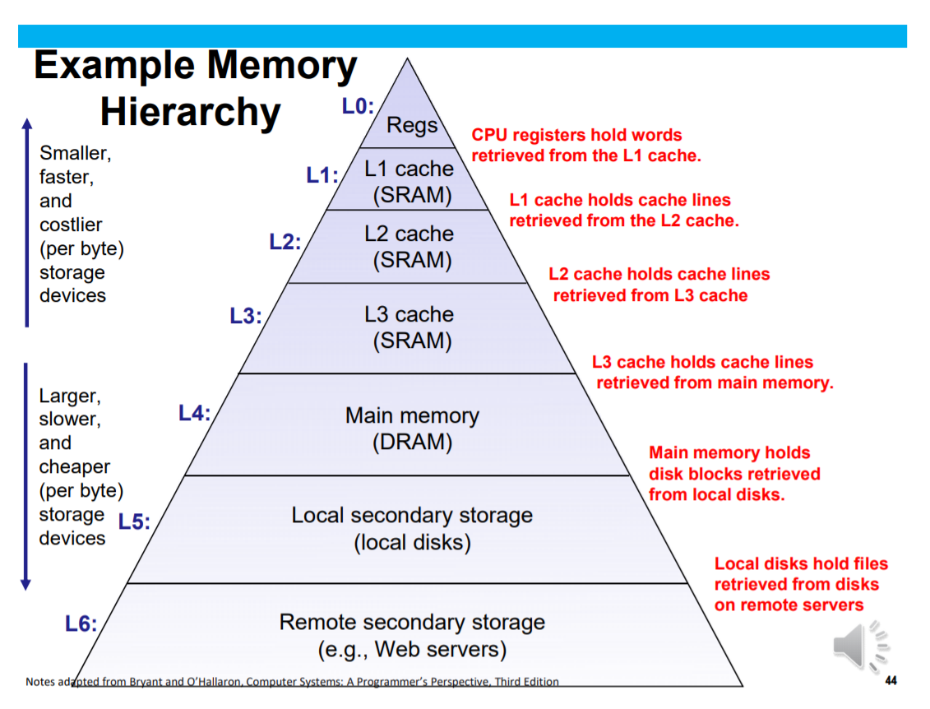
Memory Basics

Slide 7
Memory Basics
The memory hierarchy is composed of:
Caches
DRAM (4Gb, 2^32 bits)
(can hypothetically fit entire address space in main memory if our word size is 32) (hundreds of cycles access time)
Virtual memory gives each program illusion of having this
Disk (>1Tb, >2^40 bits) (millions of cycles access time)
Caches themselves have multiple levels:
L1 (~Kb, ~2^10 bits) (~1-3 cycles access)
L2/L3 (~Mb, ~2^20 bits)(~20-30 cycles access time L2)
all levels have different sizes/policies/architectures

Slide 8
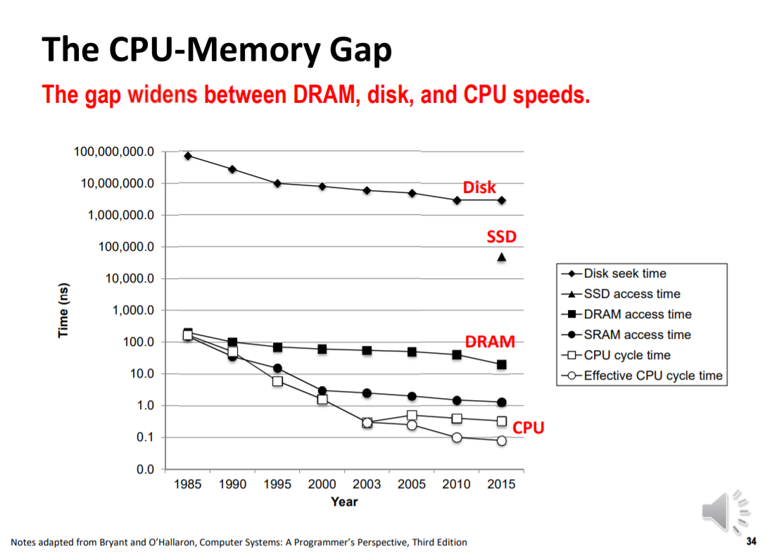
Memory Basics

Slide 9
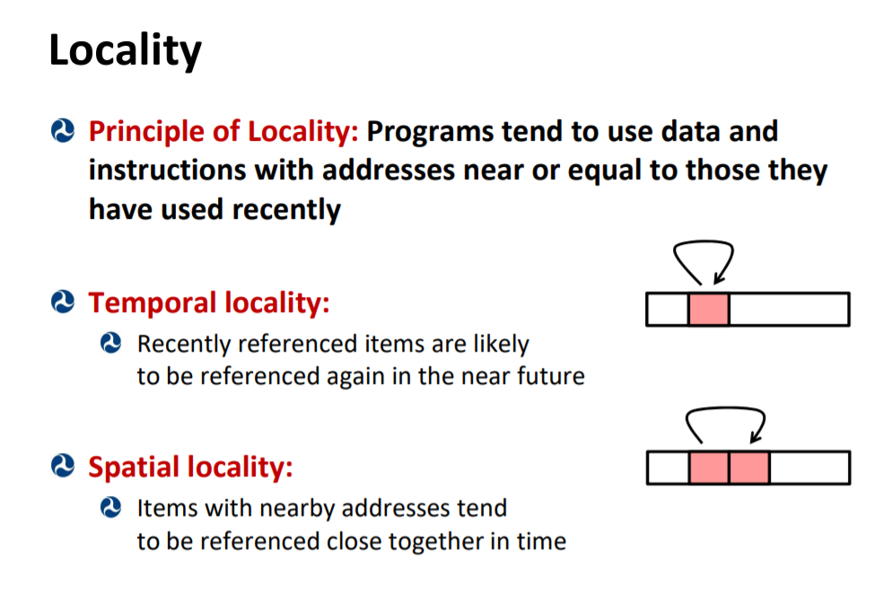
Memory Basics

Slide 10
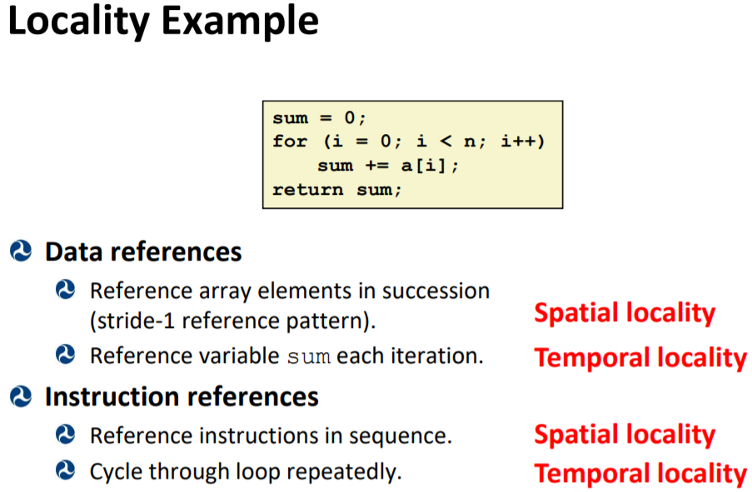
Memory Basics

Slide 11
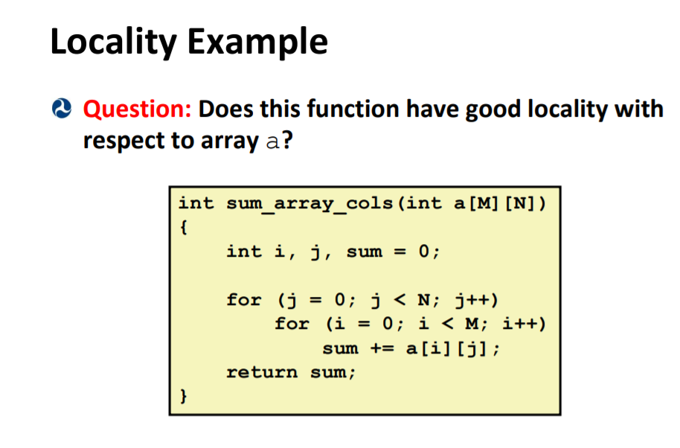
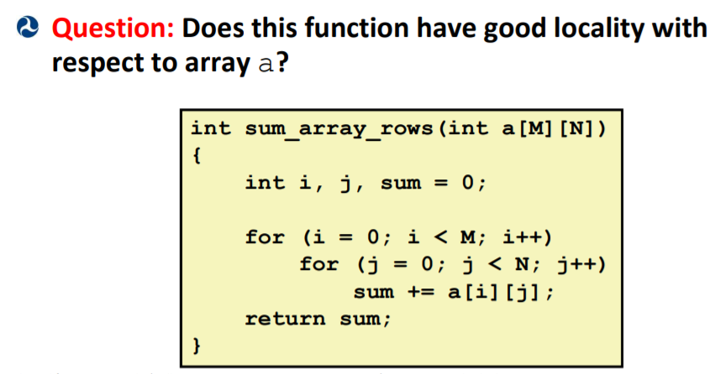
Memory Basics

Slide 12
Memory Basics

Slide 13
Caching Basics
Physical memory isn’t the instantly accessible extremely large contiguous array we want it to be
Provide the fast access with the illusion of memory the size of disk by using caching and page tables for multiple programs
Want to exploit principles of temporal and spatial locality in good cache design to reduce the cost of accessing memory to the cost of just accessing the highest level cache

Slide 14
Caching Basics
Block (line): Unit of storage in the cache
Memory is logically divided into cache blocks that map to locations in the cache
When data referenced
HIT: if in cache, use cached data instead of accessing memory
MISS: if not in cache, bring block into cache
Some important cache design decisions
Placement: where and how to place/find a block in cache?
Replacement: what data to remove to make room in cache?
Granularity of management: large, small, uniform blocks?
Write policy: what do we do about writes?
Instructions/data: do we treat them separately?

Slide 15
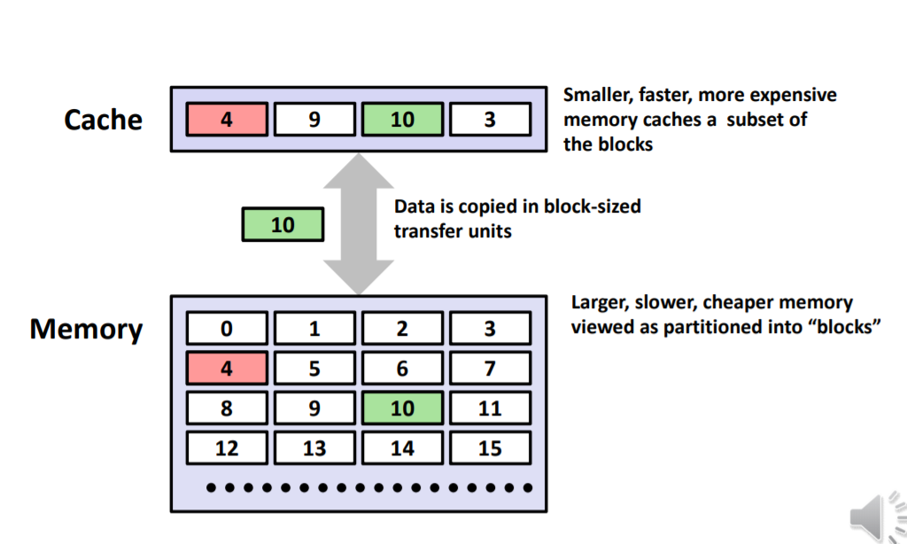
Caching Basics

Slide 16
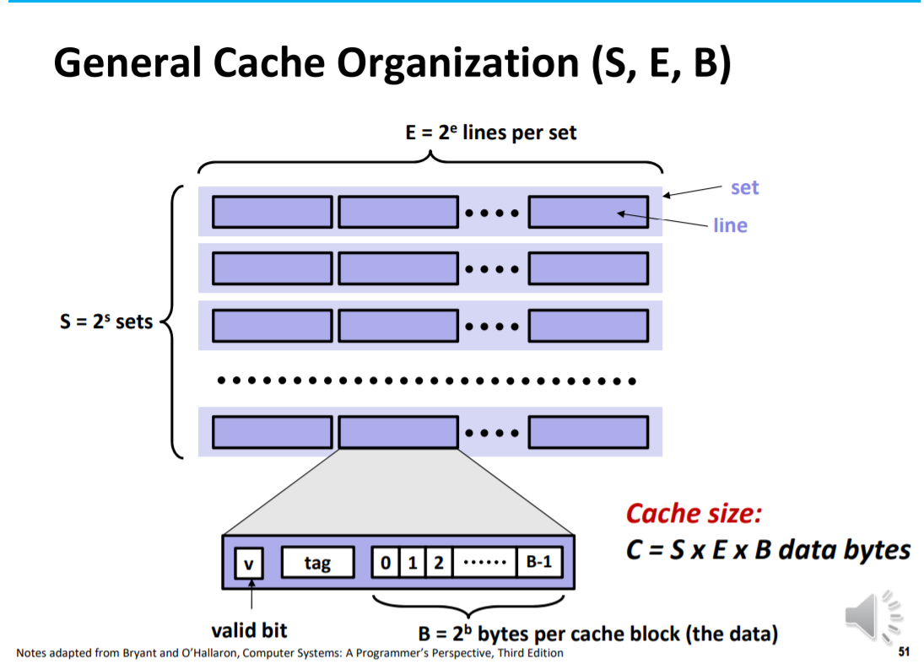
Caching Basics

Slide 17
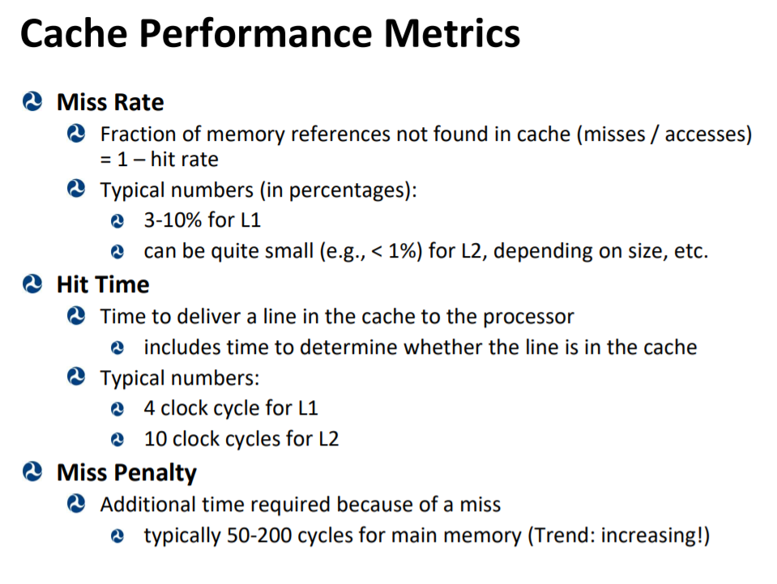
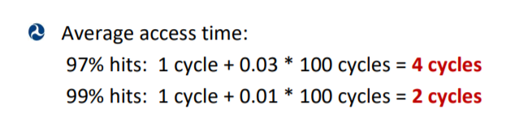
Caching Basics

Slide 18
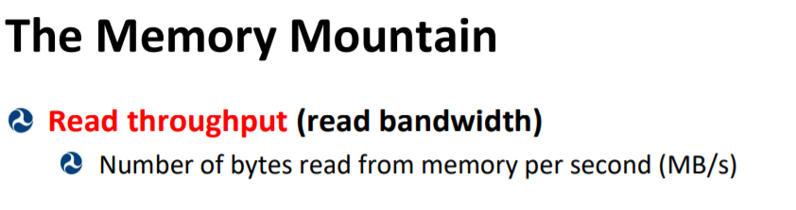
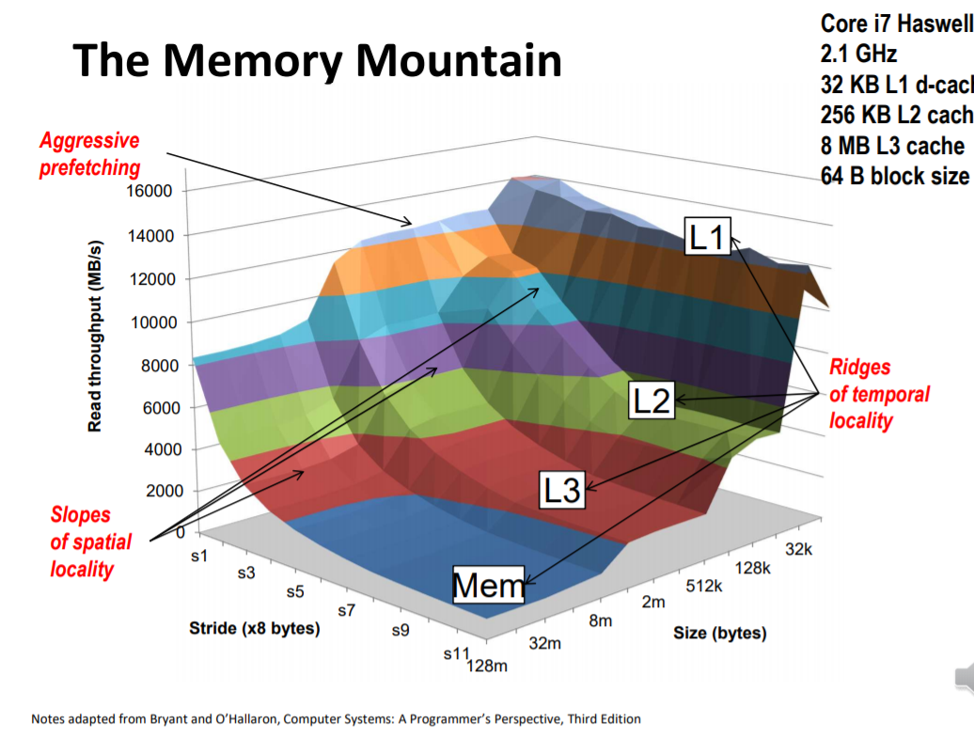
Caching Basics

Slide 19
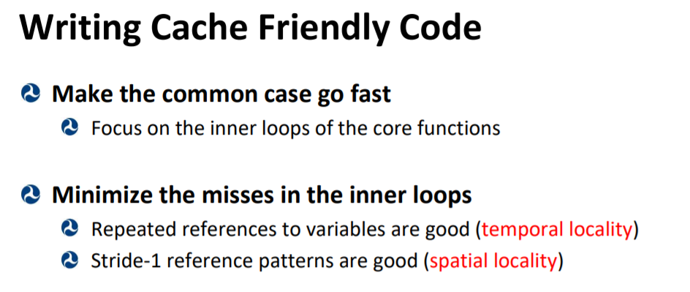
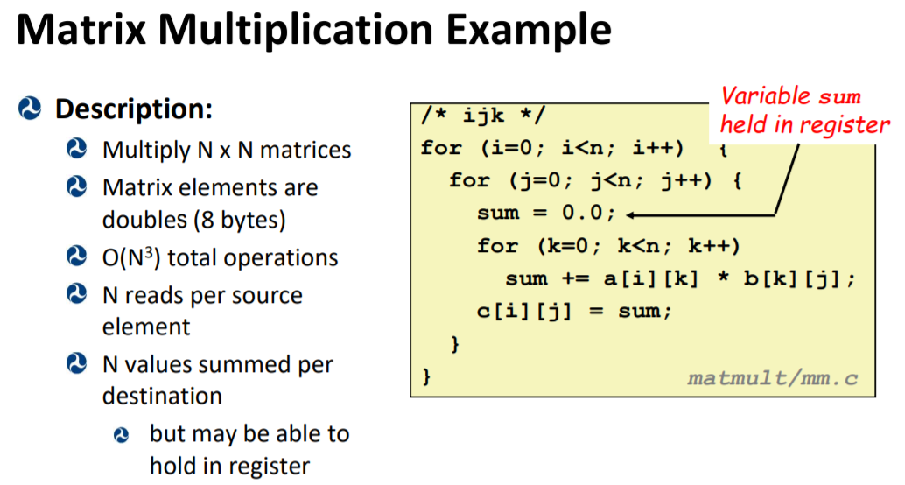
Caching Basics

Slide 20
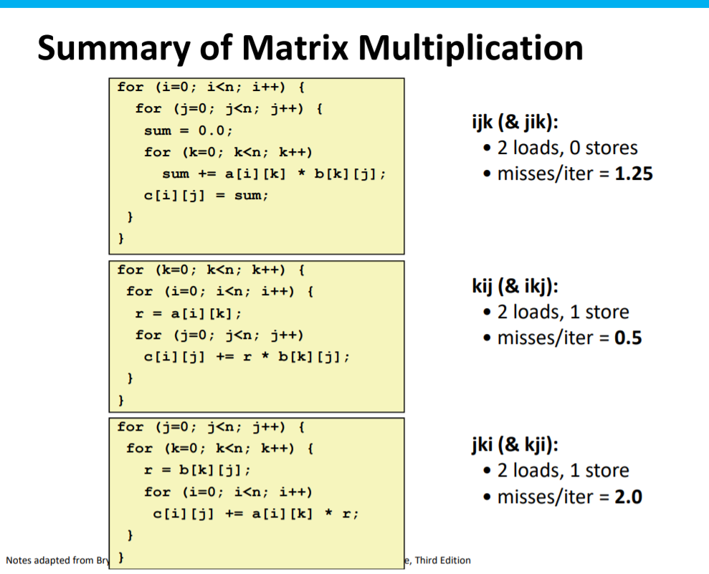
Caching Basics

Slide 21
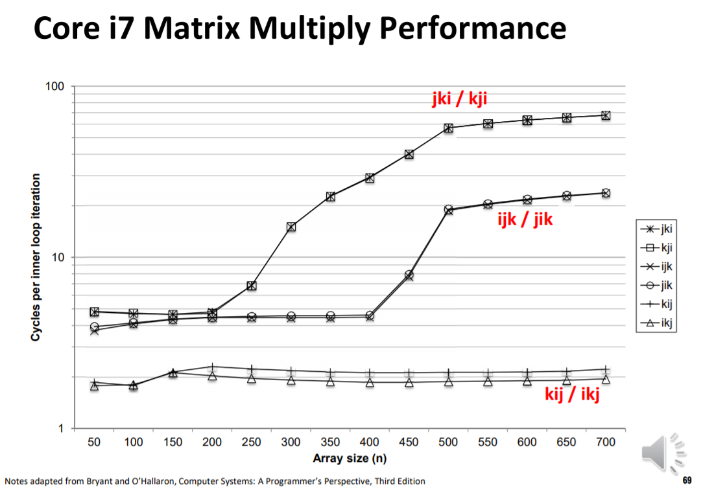
Caching Basics

Slide 22
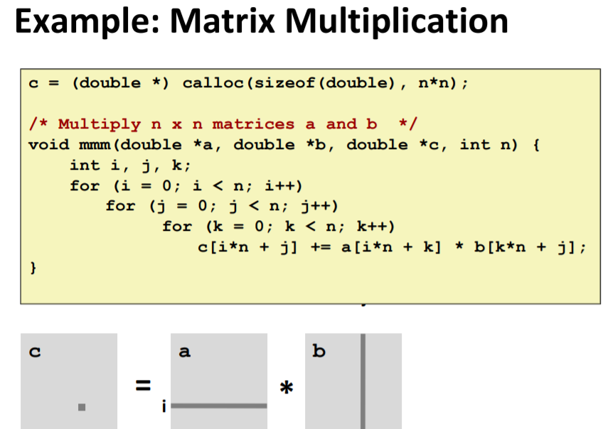
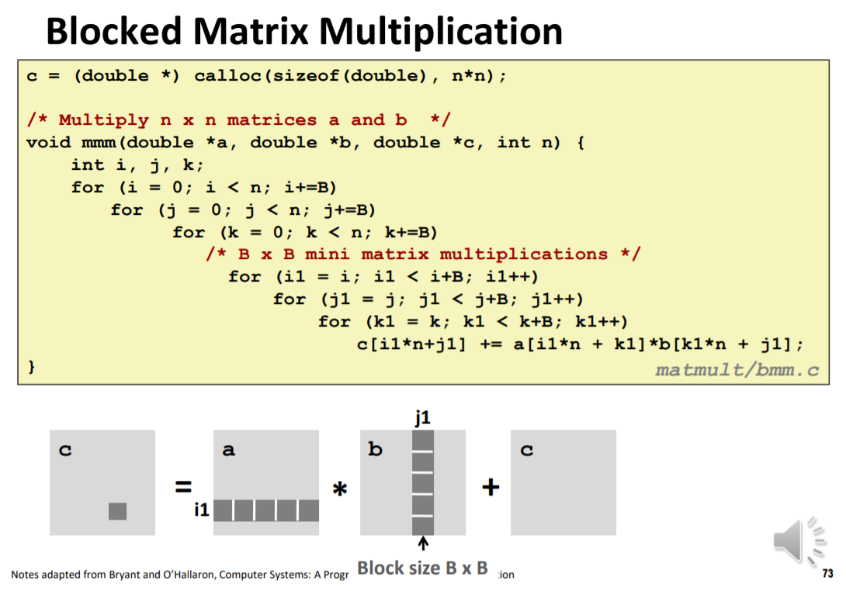
Caching Basics

Slide 23
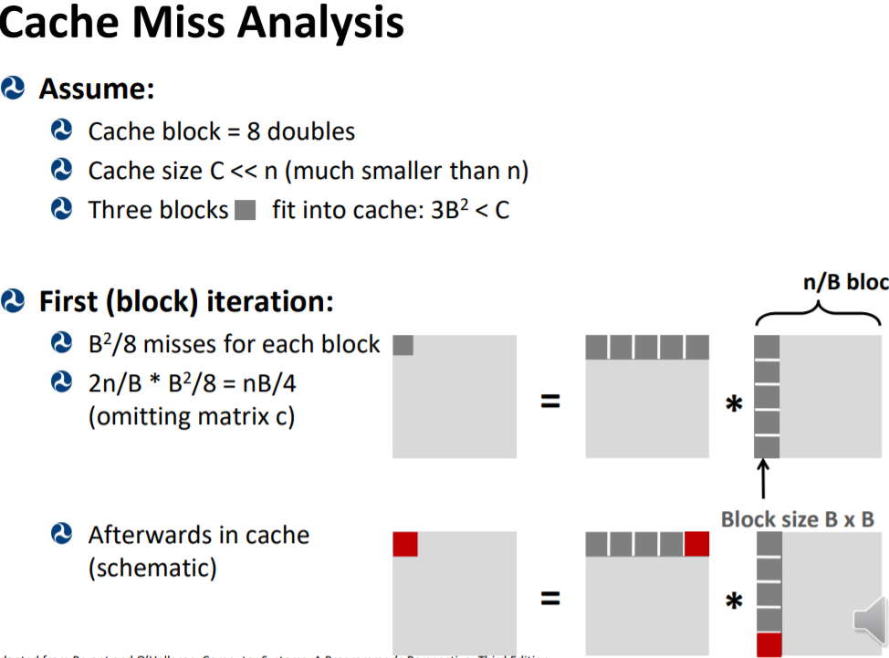
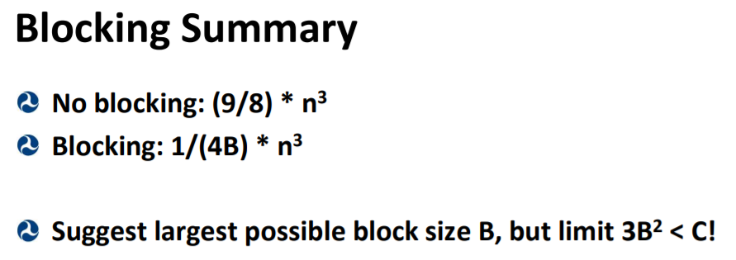
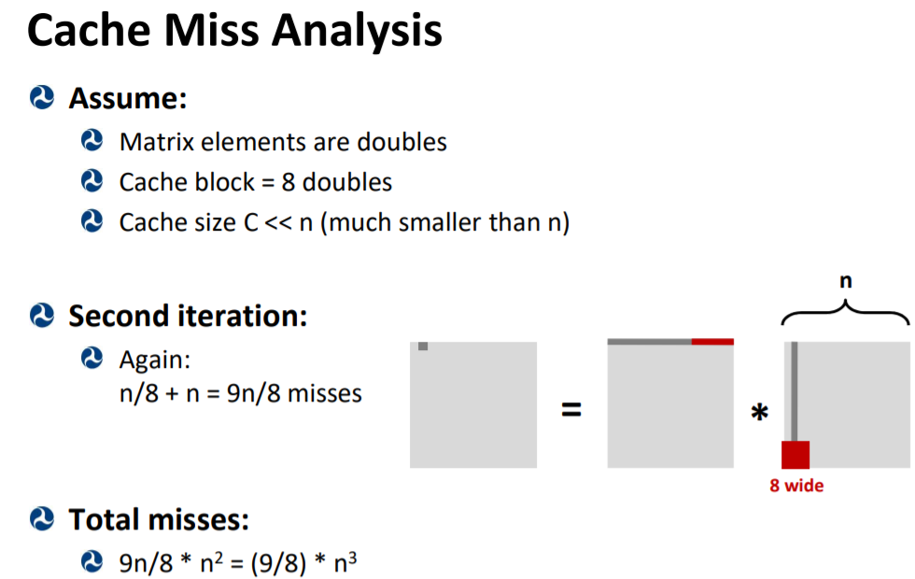
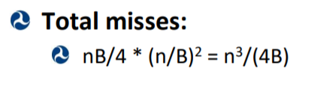
Caching Basics

Slide 24
Questions before we start worksheet?

Slide 25
Resources used
Professor Reinman’s slides (CCLE)
Credit for compilation: Attiano Purpura-Pontoniere

